Slide 1

Docker Hosting

Slide 2
XAMMP
3: Navigate to htdocs
Open phpMyAdmin (Database )
1: Install XAMPP
2: Start MySQL and Apache
4: Insert the PHP code
Finished

Slide 3
Graph
Creating Repo:Docker Hub
Push image
Install Docker
Docker File
Set up Database
Building image
Tag the image
Docker Compose file
Insert the PHP code

Slide 4
Docker Install
Visit the Docker Desktop website and download the installer.

Slide 5
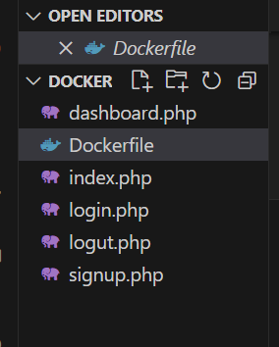
Insert the PHP code

Slide 6
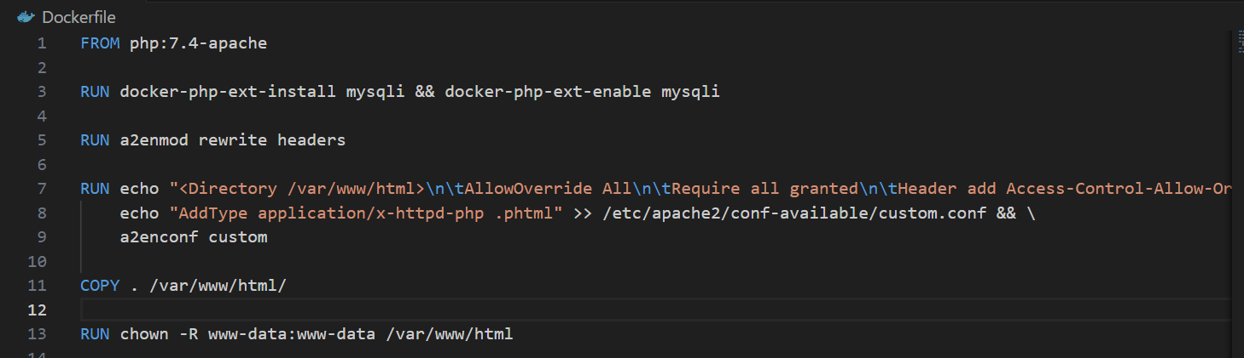
Docker File

Slide 7
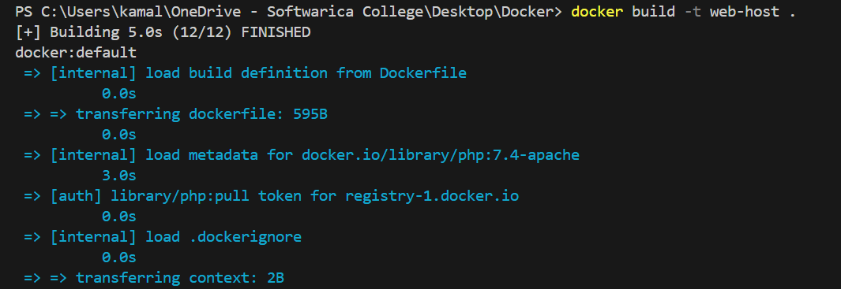
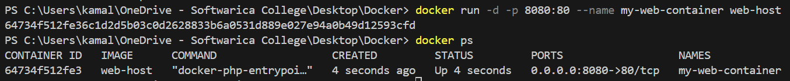
Build Images

Slide 8
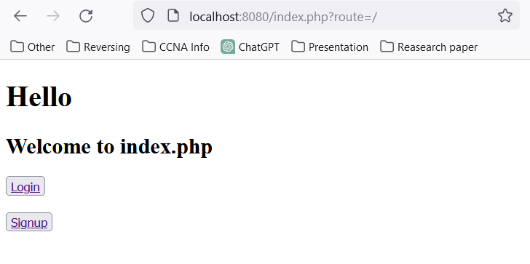
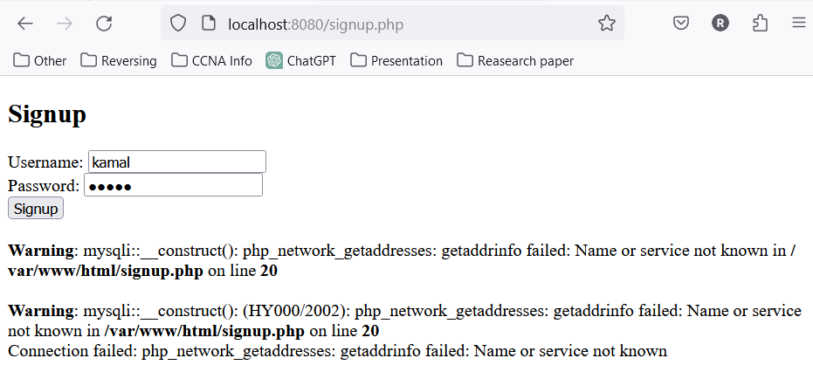
Build Images

Slide 9
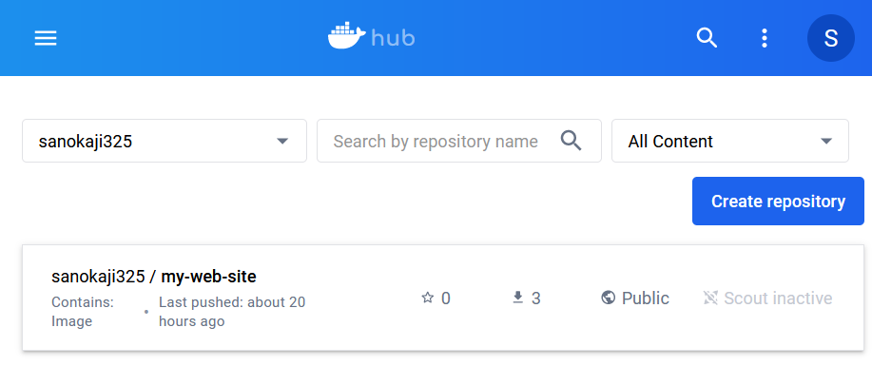
Creating Repository

Slide 10
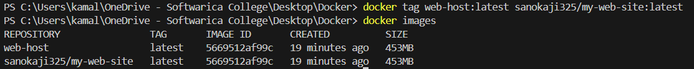
Tag Image

Slide 11
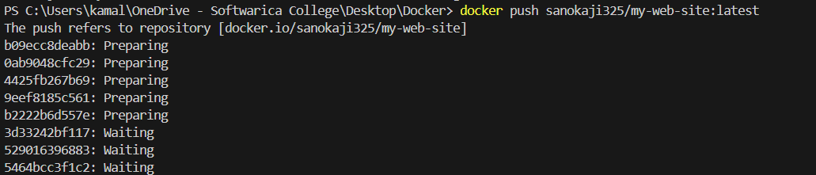
Push Image

Slide 12
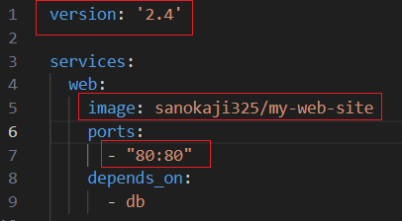
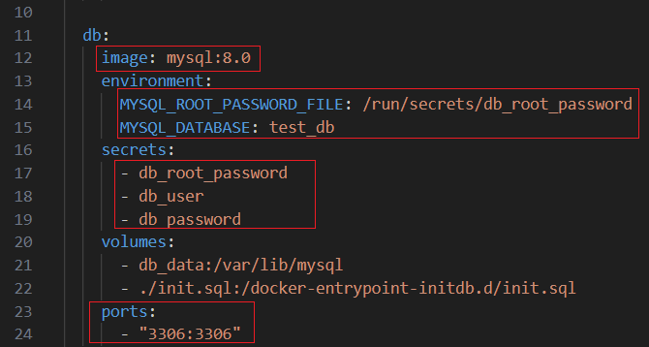
Docker Compose

Slide 13
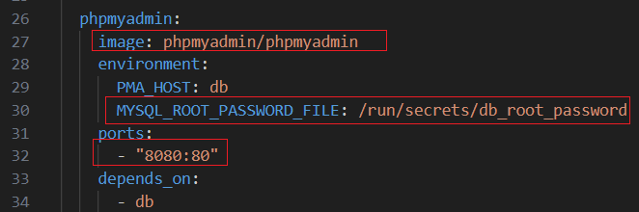
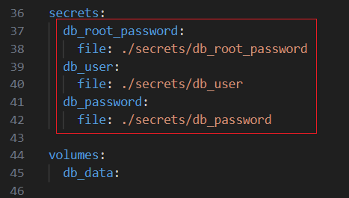
Docker Compose

Slide 14
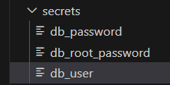
Docker Compose: Secrets

Slide 15
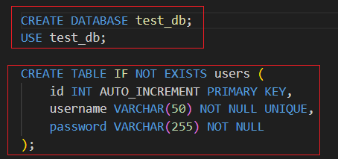
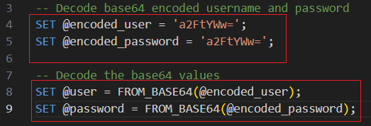
Setup Database

Slide 16
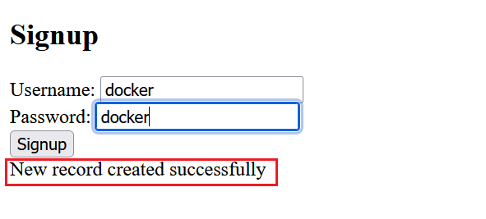
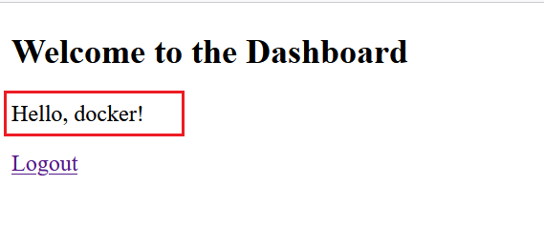
Testing

Slide 17


